Slide 1
Flight Passenger Satisfaction
(US Airline)
ACIT 4880 - Data Analytics - Project 2
Group 2: Maryam Taer, Mahsa Taer

Slide 2
03
Agenda
Visualization
EDA
Observations & Findings
Derived conclusion & suggestions
01
04
Univariate & Regression
Dataset introduction
Our dataset & its main purpose
The Attributes it contains
Confidence Interval
Hypothesis Testing
Regression & Prediction
02
05
Data Cleaning Process
Machine Learning Algorithms
Filling Missing Values
Identifying & Removing Outliers
kNN Classification
Random Forest Classification
K-Means Clustering
Accuracy Comparison

Slide 3

Data Introduction
Dataset: Flight Passenger Satisfaction
Purpose: To evaluate passengers’ satisfaction with the flight.
Source: Kaggle
Tools used: Majority with Python

Slide 4
Data Introduction (cont.) - Attributes
Flight Customer Type: Loyal customer OR disloyal customer Type of Travel: Personal Travel OR Business Travel Class: Business OR Eco OR Eco Plus Flight Distance: The flight distance of this journey Satisfaction: Passenger satisfaction level (Satisfaction, neutral or dissatisfaction) | Services (Satisfaction rate is out of 5) Departure/Arrival Time Convenient: Satisfaction level of Departure/Arrival time convenient Ease of Online Booking: Satisfaction level of online booking Food and Drink: Satisfaction level of Food and drink Departure Delay in Minutes: Minutes delayed when departure Seat Comfort: Satisfaction level of Seat comfort Check-in service: Satisfaction level of Check-in service

Slide 5

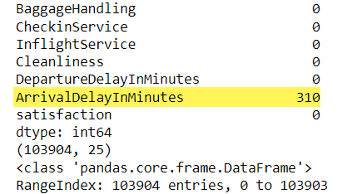
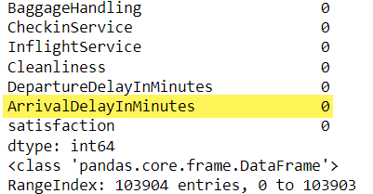
Data Cleaning
1. Finding Missing Values → 310 rows
Using df.isnull().sum()
2. Filling Them with Mean of Arrival Delay In Minutes
Notes:
After doing some inspection on the data, we start with the data cleaning.

Slide 6
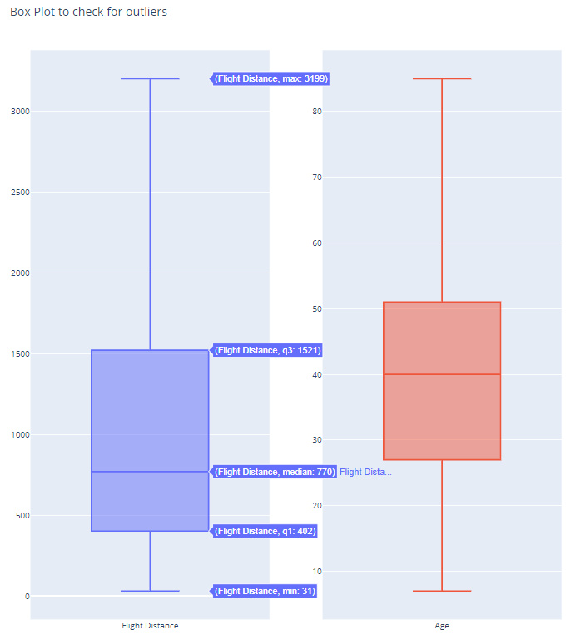
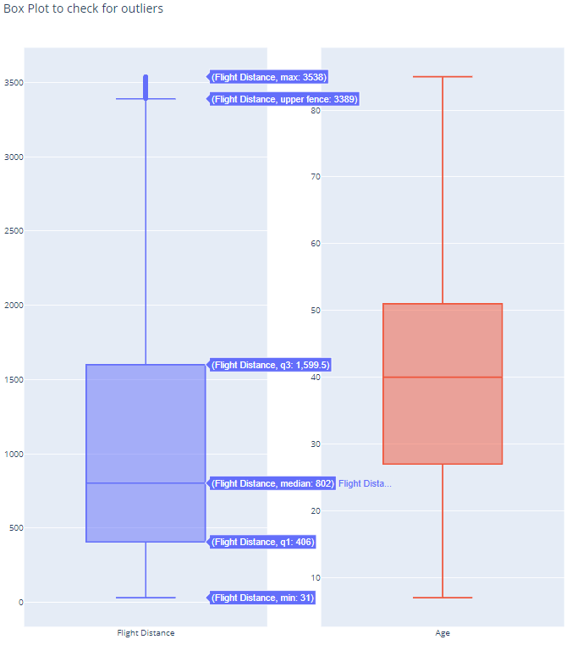
4. Identifying the Outliers
Data Cleaning
Flight Distance
Age

Slide 7

EDA
Main Objective
Find factors that have the most effect on passenger satisfaction

Slide 8

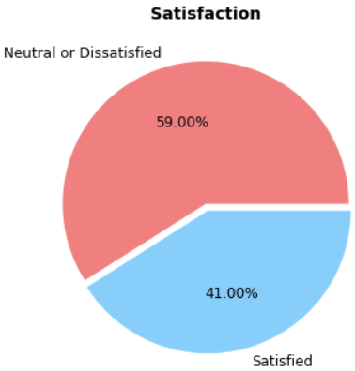
Note: All codes are documented Jupyter Notebook & submitted.
EDA - Overall Satisfaction
59% indifference or dissatisfaction.
The Airline should really address that.
We need to dig deeper.
Notes:
So the first thing we probably should do is to take a quick look at the overall passenger satisfaction, and it doesn’t look very good!
Exactly 59% of passengers of this airline are either indifferent or dissatisfied with their flights. So that’s what we need to focus on and dig into for the upcoming evaluations.

Slide 9
What is the relationship between age and flight satisfaction?
Notes:
We’re gonna start easy and set the objective here to figure out if there is any relationship between passenger age and their satisfaction (because usually with flights - especially long distance flights- age makes a determining factor)

Slide 10
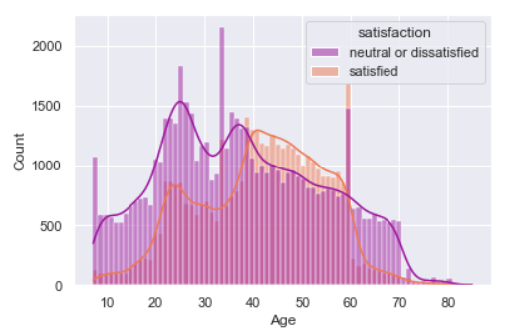
EDA - Age & Satisfaction
Passengers with age of <40 & >60 are the most satisfied in general.
The most dissatisfied group range between 20 and >40 years old.
Notes:
Alright, so it’s interesting to see that the most satisfied passengers are between 40 and 60 years old. The satisfaction level actually takes a spike around 60!
Now compared to that, it looks like younger passengers or those above 60 make the most dissatisfied group.
The dissatisfaction among these groups could be connected to factors like the level of flight services offered, flight distance, or the flight class, some of which we’re gonna take a look at in a minute.

Slide 11
How Flight Class affects Passenger Satisfaction?
Flight Classes are:
Eco
Eco Plus
Business
Notes:
Now that we have age figured out, we want to see how flight classes affect satisfaction. And the classes are “Eco”, “Eco Plus”, and “Business”.

Slide 12
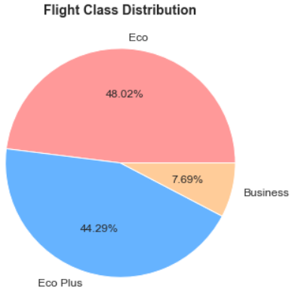
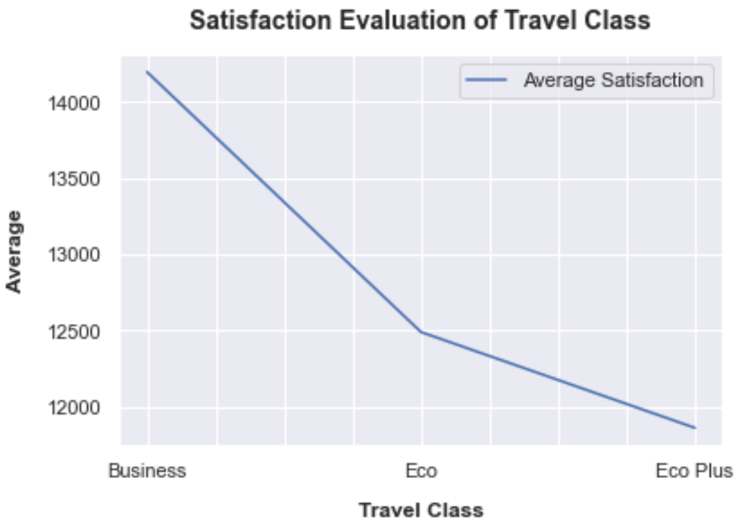
EDA - Flight Class
Notes:
So to set expectations, we have the left pie chart and it seems like the majority of passengers are leaned towards “Eco” and “Eco Plus”, so we expect to have more satisfaction for those two classes. But the plot on the right says something else.
Eco Plus so far has the worst rating in satisfaction and Business the highest. people usually want better service if they pay a little extra for Eco plus. So that’s a serious disadvantage for the airline.
We’re thinking one of the things it might have something to do with is flight distance that turns the tables? Not sure though, we need to take a look at the next slide.

Slide 13
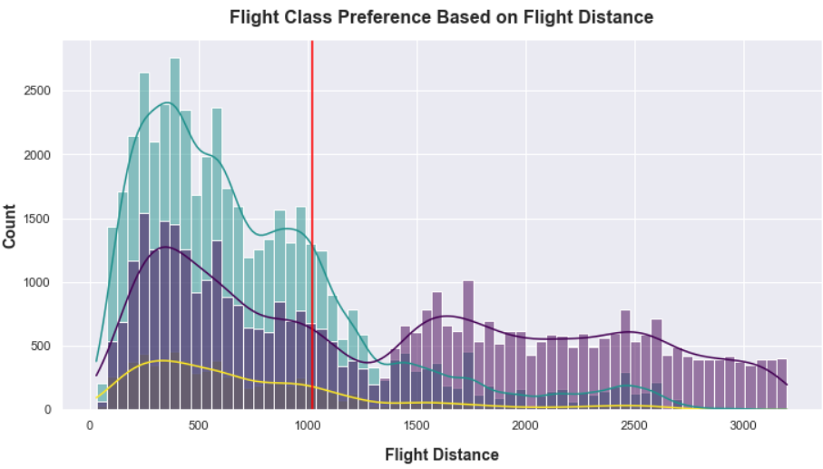

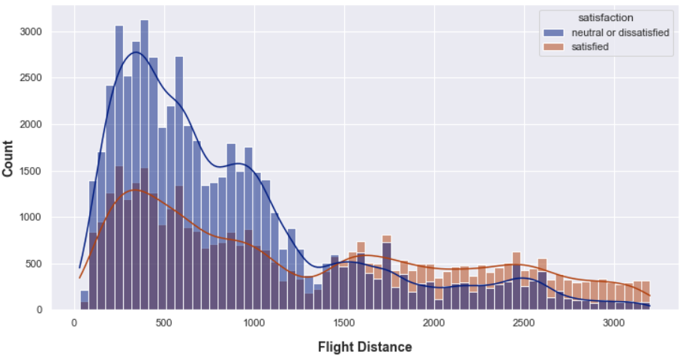
EDA - Flight Class & Satisfaction
Average refers to average flight distance.
Notes:
Sooo… yep. If you look at the purple bars, it seems like one reason that Business class has the most satisfaction is because it’s the dominant option for long distance flights.
Although the majority use Economics class for their short distance flights, they’re not really happy about it.
Business class are dominant by the business type of travel with long range flight distance

Slide 14
Let’s see who uses each flight class and for what purpose.
Customer Types are:
Loyal customers
Disloyal customers
Travel Type:
Personal
Business
Notes:
And that’s why we need to see who uses each flight class. And the factors we’re gonna be looking at are customer and travel types.

Slide 15
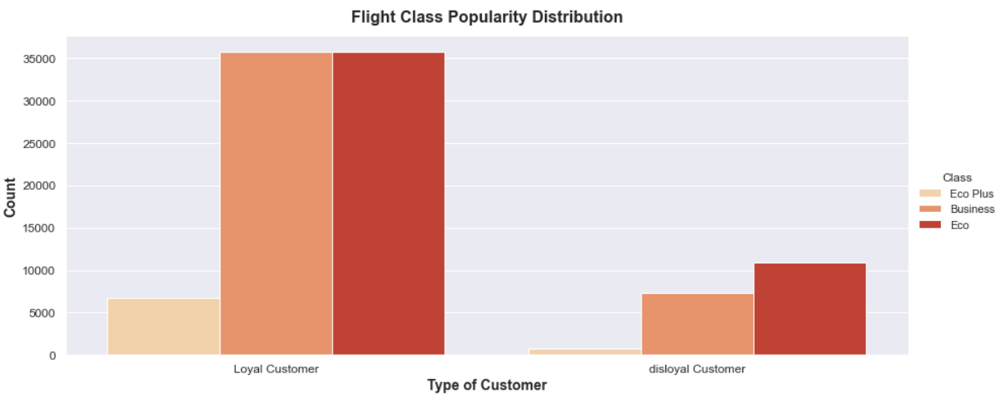
EDA - Customer Type & Class
Notes:
As expected, loyal customers of this airline are rocking both Business and Eco classes compared to the disloyal group.
And Eco Plus continues to have the least popularity among both groups.

Slide 16
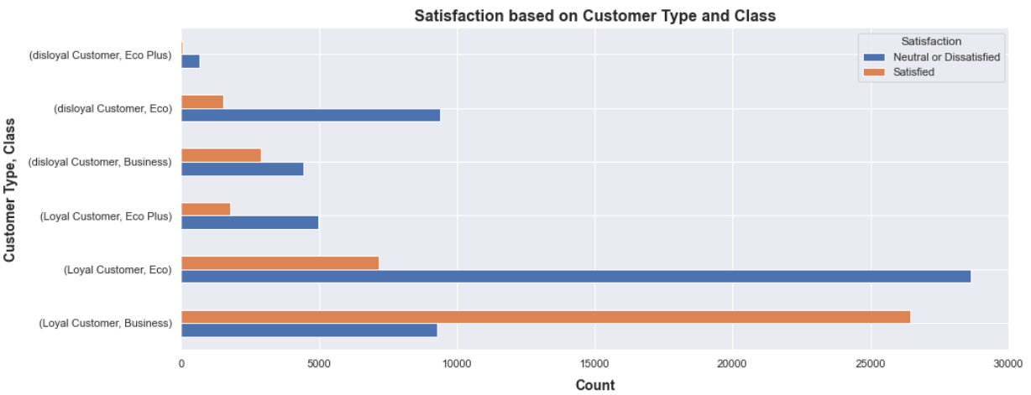
EDA - Customer Type & Class & Satisfaction
Notes:
Now when we add the satisfaction level to the previous diagram, most obvious things that we can spot quickly is that those who are Loyal customers and in the Business class are the passengers with the highest satisfaction rate.
Comparatively, passengers who are Loyal and in the Eco class are the passengers with the highest dissatisfaction rate.
Also regardless of anything, Disloyal passengers are dissatisfied with all 3 flight classes which can make sense.
In earlier slides we saw that all 3 flight classes are mostly used by loyal customers as one would expect. And so that is to say that here we can justify it since we can see that

Slide 17
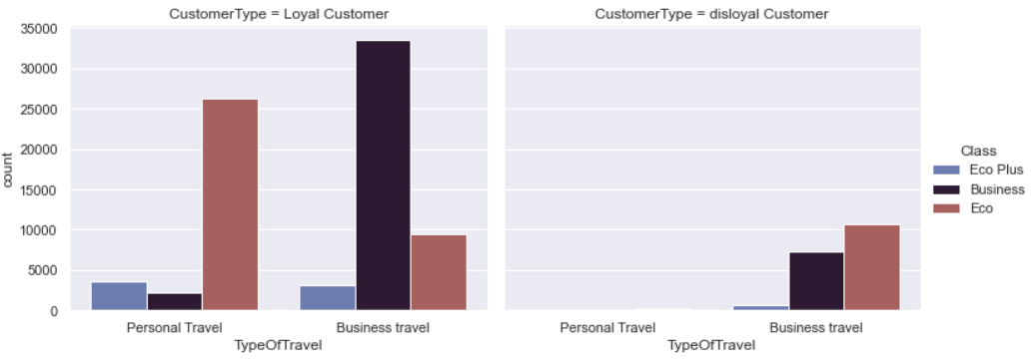
EDA - Customer Type & Class & Travel Type
Disloyal customers do not even use this airline for their personal travels!
Notes:
Just a little clarification on this slide. It’s the same as the last one except “Travel Type” is also added to the diagram. The left diagram shows analysis for “loyal customers” and the right one for the disloyal group.
So Business class for business flights and eco class for personal flight are pretty popular between loyal customers.
And at this point, we’re just gonna ignore “Eco Plus” class since it has the lowest popularity in general.
Something else we can see is that disloyal customers usually use “Eco” class for their business trips and that makes sense. If you’re not a loyal customer, why would you pay extra.
We previously saw that passengers usually choose Business class for long distance flights, therefore we can conclude that Business class are the dominant choice for business type of travel with long range flight distance.

Slide 18
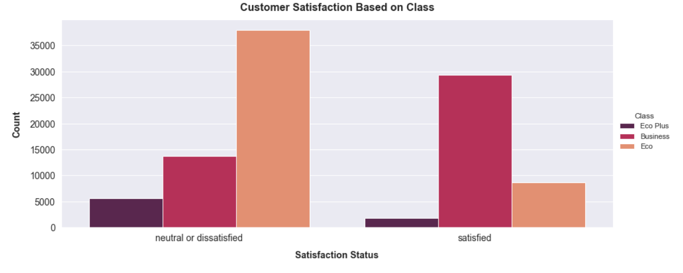
EDA - Customer Type
Notes:
So Eco Plus so far has the worst rating.
people want better service if they pay a little extra for Eco plus.
More people are satifasted.
I want to create a plan to make it work, I'll only think about how to improve the Eco Plus experience.

Slide 19
How Flight Services affect Passenger Satisfaction?
The services we are going to be evaluating satisfaction with:
Inflight Wifi Service
Inflight Entertainment
Ease of Online Booking
Seat Comfort
Note: They are all out of 5 ratings (0 being completely dissatisfied and 5, completely satisfied)
Notes:
So this section we’re going to focus on the flight services that can drastically move around the satisfaction rate. Those services are:
Inflight Wifi Service
Inflight Entertainment
Ease of Online Booking
Seat Comfort

Slide 20
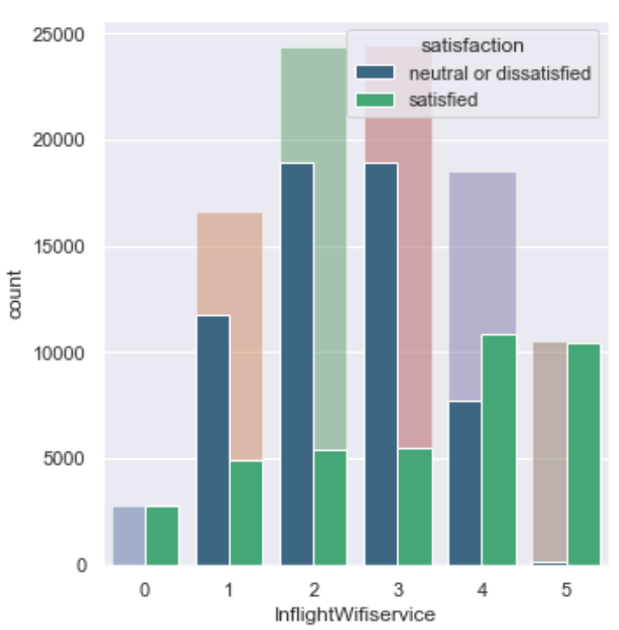
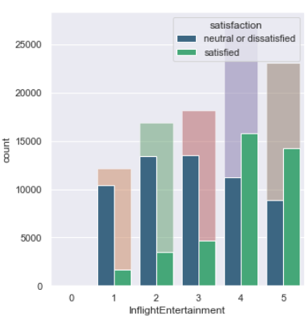
EDA - Wifi & Entertainment
Notes:
The diagrams look easier than they looks. The fade-colored bars in the back are the actual ratings for that service from 0 to 5. And the double bars in the front are the overall passenger satisfaction who gave that particular service a specific rate.
For inflight wifi service most of the data are in 2 and 3 point but still passengers end up with high dissatisfaction.
But as for Inflight Entertainment. The ratings are at 4 and 5. And we see that reflected on the overall satisfaction level for those 2 ratings.

Slide 21
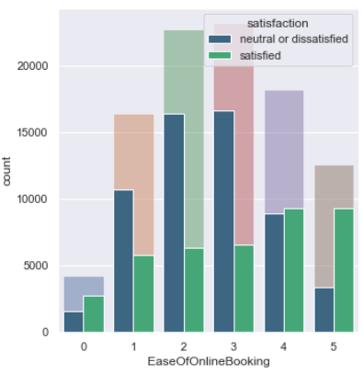
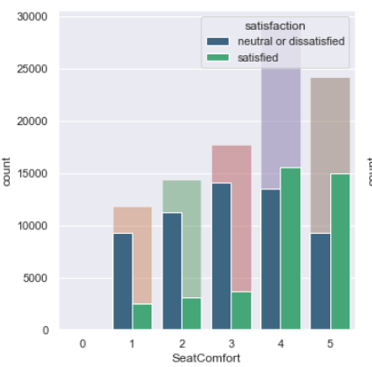
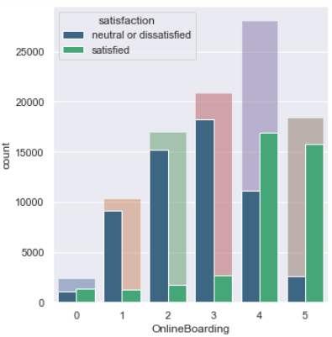
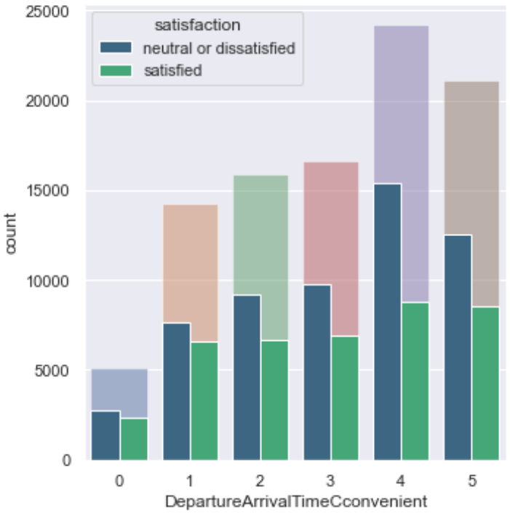
EDA - Online Booking & Seat Comfort
Notes:
Same thing here. We have ease of online booking and it looks like, if the ratings for this service decreases, the overall satisfaction drastically increases. So the airline needs to keep an easy and user-friendly online booking service to get more loyal customers.
Seat comfort also has a significant effect on increasing the satisfaction when they have high ratings. Th airline probably needs to pay attention to the level of comfort for older people who tend to be more dissatisfied and for long flights.

Slide 22
What is population mean of the flight distance for the airline’s customers?
Here, we use Univariate Statistical Analysis
Notes:
So this section we’re going to focus on the flight services that can drastically move around the satisfaction rate. Those services are:
Inflight Wifi Service
Inflight Entertainment
Ease of Online Booking
Seat Comfort

Slide 23
Univariate Statistical Analysis
Confidence Interval Estimation:
We are 95% confident that the population mean of the flight distance is between 1018.50 and 1028.46. And our margin error is 4.98.
We are 95% confident that the population mean of the Arrival Delay Minutes for loyal customers with the age of more than 50 with 100 minutes of departure delay is between 84.56 and 108.09. Our margin error is 11.76.
Confidence Interval Estimation of the Proportion:
Here, we are 95% confident that this interval captures the population proportion, and we can estimate proportion of the satisfaction of the customers to within 0.003 (or 0.3%) with 95% confidence.
Notes:
Here, our estimate for this subset is less precise that the previous one since the margin error is greater.

Slide 24
Is Arrival Delay Minutes for loyal passengers that are more than 50 years old with 100 min of departure delay differs from 2.4 with α=0.05?
Here, we use Univariate Statistical Analysis
Notes:
So this section we’re going to focus on the flight services that can drastically move around the satisfaction rate. Those services are:
Inflight Wifi Service
Inflight Entertainment
Ease of Online Booking
Seat Comfort

Slide 25
Univariate Statistical Analysis
Hypothesis Testing for the Mean:
Here, we tested a null hypothesis to see whether mean Arrival Delay Minutes for loyal customers with the age of more than 50 with 100 minutes of departure delay differs from 2.4 with a level of significance α=0.05. As a result, p-value is greater than 0.05 which means that the null hypothesis is not rejected.
Hypothesis Testing for the Proportion:
Here, we tested a null hypothesis to see with 1142 of 97248 customer satisfied differs from 0.15 with a level of significance α=0.10. As a result, z_data is less than 0 and p-value is less than 0.10 which means that we would reject H0.
Notes:
Here, our estimate for this subset is less precise that the previous one since the margin error is greater.

Slide 26
What will be the predicted Flight Distance for a customer in a certain scenario?
Here, we use Linear Regression Model
Notes:
So this section we’re going to focus on the flight services that can drastically move around the satisfaction rate. Those services are:
Inflight Wifi Service
Inflight Entertainment
Ease of Online Booking
Seat Comfort

Slide 27

Linear Regression
Linear Regression Model for FlightDistance as Target & Prediction:
CustomerType = 1
Age = 90
TypeOfTravel = 0
Class = 0
InflightWifiservice = 4
DepartureArrivalTimeCconvenient = 5
EaseOfOnlineBooking = 3
GateLocation = 1
FoodAndDrink = 4
OnlineBoarding = 3
SeatComfort = 2
InflightEntertainment = 1
FlightDistance = 678.19824137 Km
OnBoardService = 4
LegRoomService = 3
BaggageHandling = 1
CheckinService = 1
InflightService = 2
Cleanliness = 3
DepartureDelayInMinutes = 100
ArrivalDelayInMinutes = 5
Satisfaction = 0
Gender_Female = 0
Gender_Male = 1
Notes:
Here, our estimate for this subset is less precise that the previous one since the margin error is greater.

Slide 28
Will a customer be satisfied with their flight in a certain scenario?
Here, we use Logistic Regression Model
Notes:
So this section we’re going to focus on the flight services that can drastically move around the satisfaction rate. Those services are:
Inflight Wifi Service
Inflight Entertainment
Ease of Online Booking
Seat Comfort

Slide 29
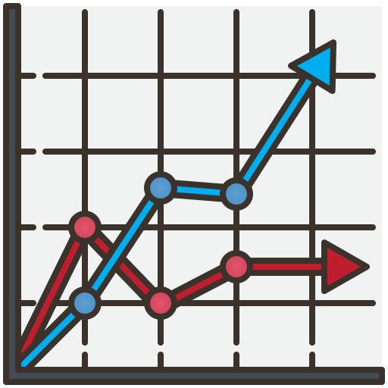
Logistic Regression
Logistic Regression Model for satisfaction as Target & Prediction:
CustomerType = 1
Age = 90
TypeOfTravel = 0
Class = 0
FlightDistance = 2500
InflightWifiservice = 4
DepartureArrivalTimeCconvenient = 5
EaseOfOnlineBooking = 3
GateLocation = 1
FoodAndDrink = 4
OnlineBoarding = 3
SeatComfort = 2
satisfaction = 1
InflightEntertainment = 1
OnBoardService = 4
LegRoomService = 3
BaggageHandling = 1
CheckinService = 1
InflightService = 2
Cleanliness = 3
DepartureDelayInMinutes = 100
ArrivalDelayInMinutes = 5
Gender_Female = 0
Gender_Male = 1
Notes:
Here, our estimate for this subset is less precise that the previous one since the margin error is greater.

Slide 30
Will the customer be satisfied given a certain scenario based on kNN Classification?
Here, we use K Nearest Neighbor Classification
Notes:
So this section we’re going to focus on the flight services that can drastically move around the satisfaction rate. Those services are:
Inflight Wifi Service
Inflight Entertainment
Ease of Online Booking
Seat Comfort

Slide 31
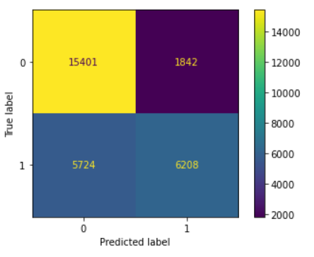




K-Nearest Neighbor (kNN) Classification
kNN Classification for Satisfaction of the Customer: Gender = 0 CustomerType = 1 Age = 13 TypeOfTravel = 0 Class = 1 FlightDistance = 460 InflightWifiservice = 3 DepartureArrivalTimeCconvenient = 4 EaseOfOnlineBooking = 3 GateLocation = 1 FoodAndDrink = 5 Satisfaction = 0
OnlineBoarding = 3
SeatComfort = 5
InflightEntertainment = 5
OnBoardService = 4
LegRoomService = 3
BaggageHandling = 4
CheckinService = 4
InflightService = 5
Cleanliness = 5
DepartureDelayInMinutes = 25
ArrivalDelayInMinutes = 18
True Negative
False Negative
False Positive
True Positive
Notes:
Here, our estimate for this subset is less precise that the previous one since the margin error is greater.

Slide 32
Will the customer be satisfied given a certain scenario based on Random Forest Classification?
Here, we use Random Forest Classification
Notes:
So this section we’re going to focus on the flight services that can drastically move around the satisfaction rate. Those services are:
Inflight Wifi Service
Inflight Entertainment
Ease of Online Booking
Seat Comfort

Slide 33
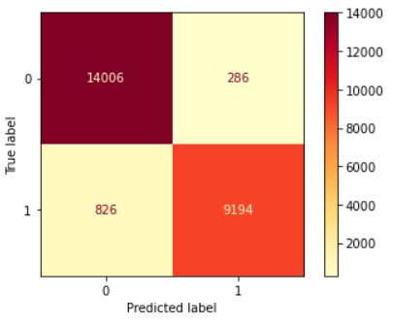



Random Forest Classification
Random Forest Classification for Satisfaction of the Customer: Gender = 0 CustomerType = 1 Age = 13 TypeOfTravel = 0 Class = 1 FlightDistance = 460 InflightWifiservice = 3 DepartureArrivalTimeCconvenient = 4 EaseOfOnlineBooking = 3 GateLocation = 1 FoodAndDrink = 5 Satisfaction = 0
OnlineBoarding = 3
SeatComfort = 5
InflightEntertainment = 5
OnBoardService = 4
LegRoomService = 3
BaggageHandling = 4
CheckinService = 4
InflightService = 5
Cleanliness = 5
DepartureDelayInMinutes = 25
ArrivalDelayInMinutes = 18
Top Right- False Positive
Bottom Left - False Negative
True Negative
True Positive
Notes:
Here, our estimate for this subset is less precise that the previous one since the margin error is greater.

Slide 34
What is the precision & confusion Matrix of K-Means Clustering for Satisfaction of a customer?
Here, we use K-Means Clustering based on Satisfaction
Notes:
So this section we’re going to focus on the flight services that can drastically move around the satisfaction rate. Those services are:
Inflight Wifi Service
Inflight Entertainment
Ease of Online Booking
Seat Comfort

Slide 35
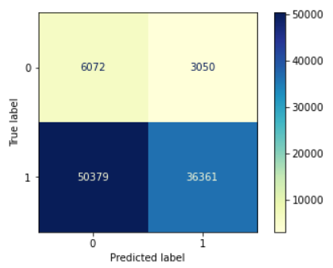
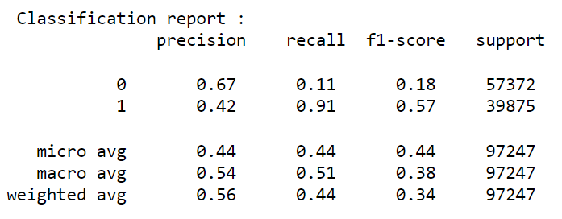




K-Means Clustering
True Negative
False Negative
False Positive
True Positive
Notes:
Here, our estimate for this subset is less precise that the previous one since the margin error is greater.

Slide 36
What is the characteristics of the satisfied customers in the dataset?
Here, we use K-Means Clustering based on Satisfaction
Notes:
So this section we’re going to focus on the flight services that can drastically move around the satisfaction rate. Those services are:
Inflight Wifi Service
Inflight Entertainment
Ease of Online Booking
Seat Comfort

Slide 37
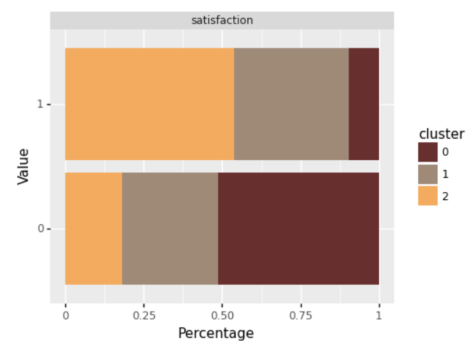
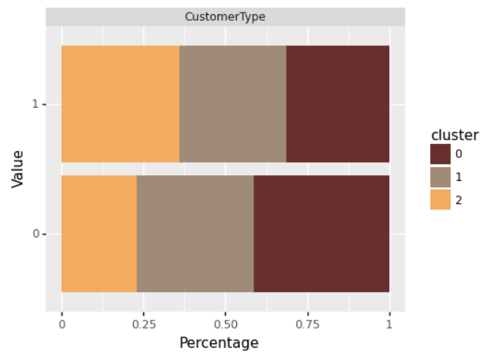
K-Means Clustering (Satisfaction & Customer Type)
0: Neutral or Dissatisfied
1: Datisfied
0: Disloyal Customer
1: Loyal Customer
Notes:
So the elbow method decided we have 3 custers and we did. And just a side note here, since most of our data was categorical, a scatter plot didn’t really work hence the bar plot.
The bar plot on the left side, is the level of satisfaction of the passengers in all 3 clusters. Just by looking at it, cluster 2 is the dominant cluster in having the highest percentage in satisfied passengers (it’s a tiny bit over 50%).
On to the next one, we have cluster 1 (the greyish one) that has the second highest satisfied passengers. And cluster 0 is really aiming for dissatisfaction because nearly 50% of dissatisfied passengers are grouped into cluster 0.
Now what we want to see is what factors resulted the satisfaction levels to be distributed like this between clusters and that’s when we can find out what factors the airline should focus on to increase satisfaction.
So, that’s why we move on to the right diagram where it’s clear that cluster 2 with highest satisfaction happen to have the highest loyal customers among compare to the other 2, and it makes sense. There must have been some services that they were pretty satisfy with to become a loyal customer. We’re gonna take a look at those services in a minute.

Slide 38
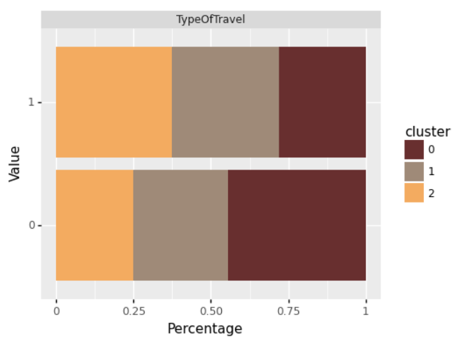
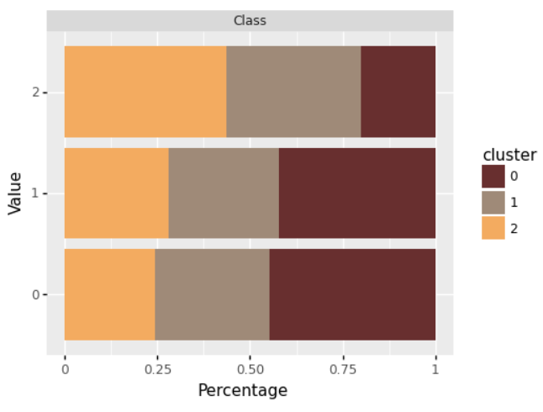
K-Means Clustering (Type of Travel & Class)
0: Eco
1: Eco Plus
2: Business
0: Personal Travel
1: Business travel
Notes:
Here we have the same clustering for Travel type and flight Class where we can see that cluster 2 being the most satisfied, have the highest business travel record and are predominant with using Business Class. Also, earlier in the EDA section we saw that Eco Plus had basically the worst satisfaction rating and we can justify that here by looking at cluster 0 & 1 in the right plot where Eco Plus class seems to have more popularity. SO that’s definitely something that the airline should address.

Slide 39
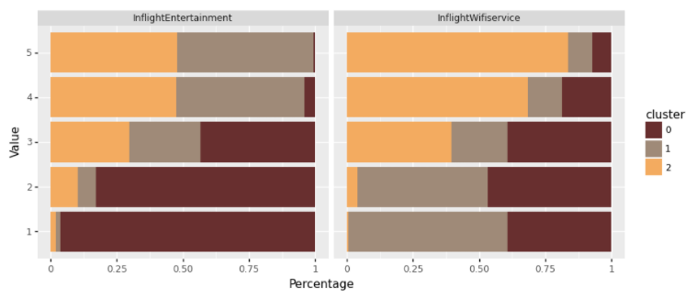
K-Means Clustering (Inflight Ent. & Inflight Wifi Service)
Notes:
So in this and the next slide, we’re gonna do the same analysis on 4 of the services offered by the airline to see how they are distributed between clusters.
Here, we have Inflight Entertainment (things like movies, music, etc) and inflight Wifi Service. And seems like Inflight Wifi service is a good determining factor for increasing satisfaction because cluster 2’s rating of this service ranges between 3 to 5.
On the other hand, Inflight Entertainment seems to have very low rating (between 1 to 3) for cluster 0 which we established to have the most dissatisfaction rate among clusters. So we CAN say that low inflight entertainment can have an important role in decreasing satisfaction.

Slide 40
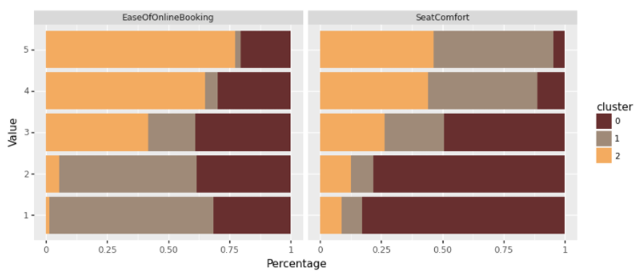
K-Means Clustering (Ease of Online Booking & Seat Comfort)
Notes:
Ok the services we’re looking at here are ease of online booking and seat comfort. Again cluster 2 holds the highest rating of 3 to 5 for ease of online booking, so this could be another factor that can directly cause satisfaction level to fluctuate. And last but not least, seat comfort got some noticeable low ratings from cluster 0 which again brings us back it being important (especially for younger and older people) when analyzing satisfaction. I say younger and older passengers because earlier we saw that middle aged passengers between 40-60 were the most satisfied.
Alright, cool, now I pass it on to mahsa for final words.

Slide 41
What is the Accuracy comparison for Random Forest & kNN Classification, and K-Means Clustering?
Here, we use a bar plot to compare the accuracy
Notes:
So this section we’re going to focus on the flight services that can drastically move around the satisfaction rate. Those services are:
Inflight Wifi Service
Inflight Entertainment
Ease of Online Booking
Seat Comfort

Slide 42
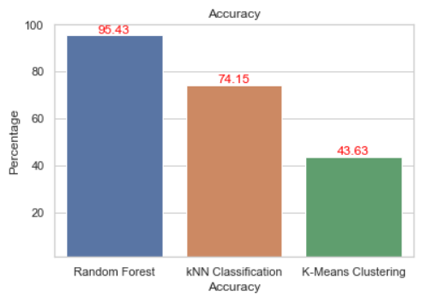
Accuracy Comparison
Random Forest Classification has the highest accuracy compared to kNN classification and K-Means Clustering.
Notes:
Here, our estimate for this subset is less precise that the previous one since the margin error is greater.

Slide 43


